Slide 1
Wi-fi mini project group no.15

Slide 2
1.introduction
Wi-Fi is the shorthand for "Wireless Fidelity," which is a technology that enables wireless connectivity between devices for the purpose of data transmission.
The aim and purpose of this project is to address the WI-FI network problems before placement of access point within basement of block D which may enhance user satisfactions

Slide 3
2.Background and context
Administration building of block D consist of two floors including basement levels that are occupied by various departments.
Type of WI-FI router used: The WI-FI Router used for network connection was from LINKSYS E900 Manufacturer which is classified as a single-band router, operating on a single frequency band typically 2.4GHZ.
This means that it offers WI-FI connectivity on the 2.4GHZ band only.

Slide 4
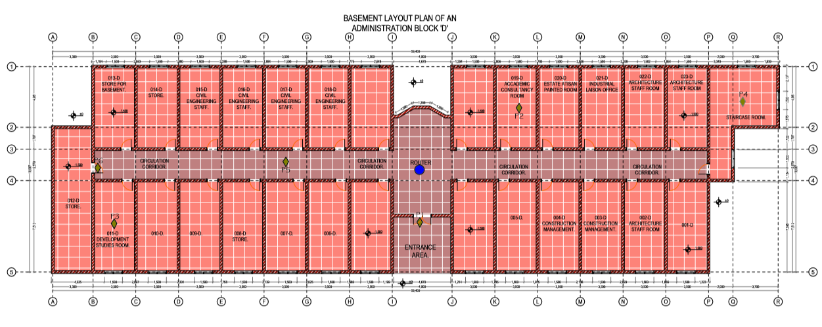

Slide 5
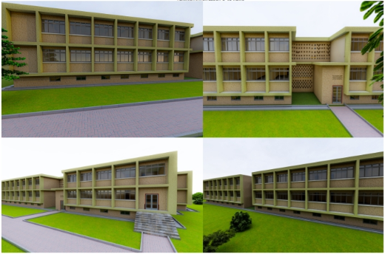

Slide 6
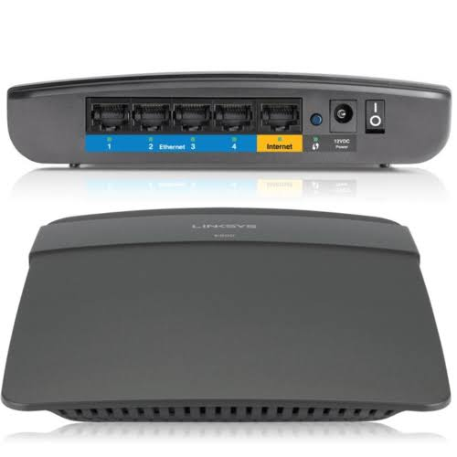
Linksys e900

Slide 7
Problems wi-fi users in basement of block d
Slow or Inconsistent Speeds: Users have reported slow or inconsistent Wi-Fi speeds when connected to the Linksys E900 router. This issue usually affect internet browsing and file transfers, leading to frustration and inconvenience.
Connection Drops: Some users have experienced frequent disconnections in the Wi-Fi connection when using the Linksys E900 router. This disrupted their online activities and required users to reconnect their devices frequently

Slide 8
3.Problem statement
We have a challenging environment for wireless connectivity in basement of administration building block D.

Slide 9
4.Main objective
Designing a new WI-FI network installation with higher performance so that every user in basement of block D administration building may have an efficient access to the internet.

Slide 10
5.Specific objectives
To identify causes for WI-FI network problem in basement of administration building of block D.
To propose solutions for enhancing WI-FI connectivity in basement of administration building of block D.
To determine the optimal placement of access point within basements of administration block D

Slide 11
6.methodology
To investigate the WI-FI network problem site visits were conducted to assess the existing network infrastructure.
. Network performance measurements were taken with the aid of WI-FI signal strength meter App in different areas of the basement offices.
Interviews were conducted with the employees to gather their feedback and experiences.

Slide 12
7.Scope of the mini-project
The basement layout was assessed and the following features were determined;
Structural characteristics
-Lower ceiling height
-Foundation walls of reinforced concrete
-Reinforced structural elements

Slide 13
Obstacles
-Wooden door
-Concrete walls
-Fans
Area of weak signals
Ref: Basement layout plan of an administration block ‘D’
-012-D STORE
-013-D STORE FOR BASEMENT
-011-D DEVELOPMENT STUDIES ROOM

Slide 14
Access point placement
To determine a specific point for placement of a WI-FI router the variation of power signal received by different users at different position must not differ at big a range, and this will be observed at the next step of data collection where by at that condition each user will have equal access of data.

Slide 15
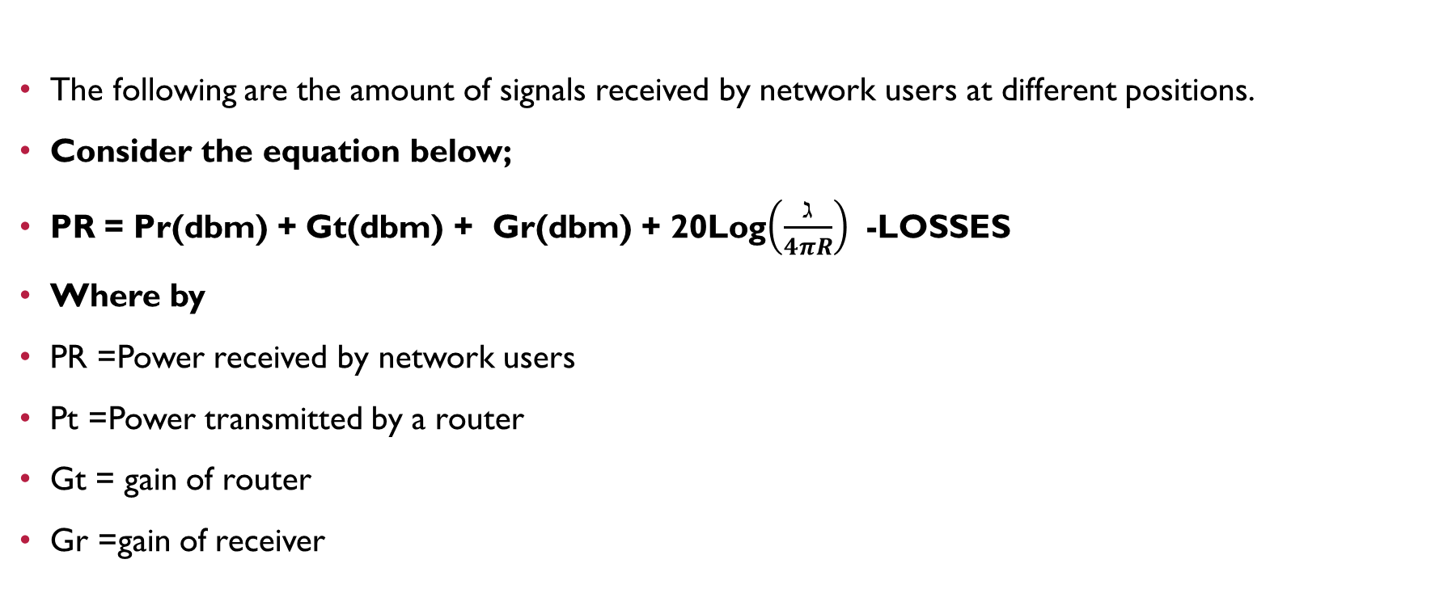
8.Data collection and analysis

Slide 16
Wavelength
R = distance between a transmitter and receiver
The following are some of losses that might affect the transmitted signal according to the area of assessment;
loss due to wall (9-12) dbm
loss due to wooden door (2-4) dbm

Slide 17
REF: LINKSYS E900 SPECIFICATIONS
POWER =20dbm
GAIN =3dbm
FREQUENCY =2.4GHZ
Assuming all network users using smartphones, the gain of receiving will approximately to 1dbm

Slide 18
Distance cases
CASE 01: Po
R =1.3m
Pt=20dbm (from WI-FI router in either sides)
Gt=3dbm
Gr=1dbm
Wavelength=0.125m

Slide 19
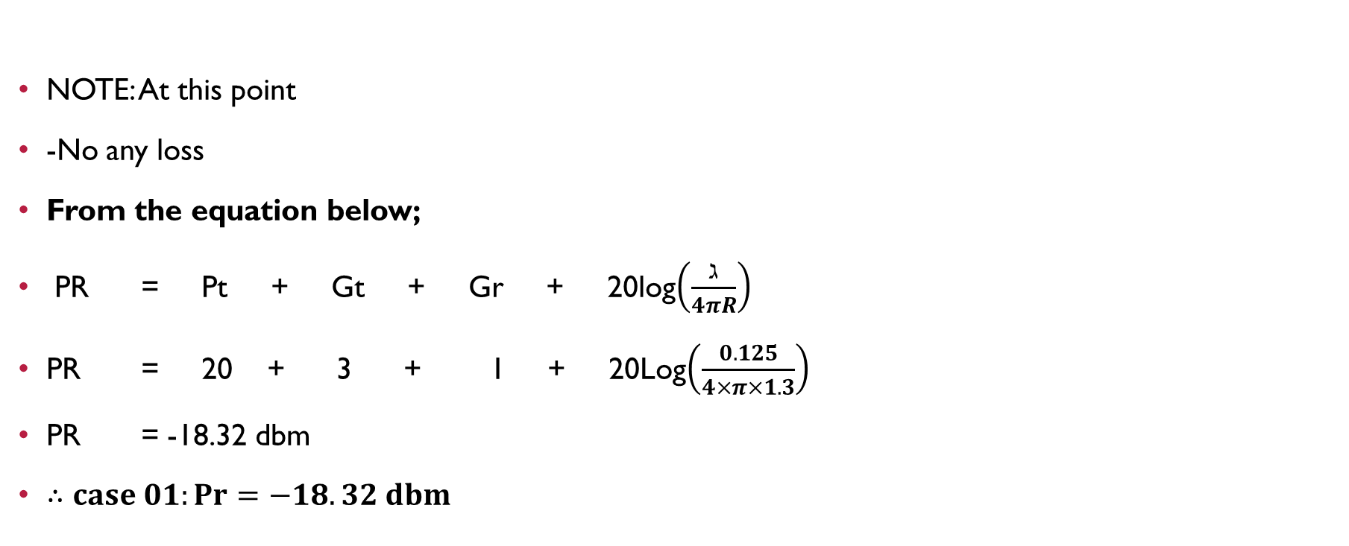

Slide 20
CASE 02: P1
R =4.3m
Pt=20dbm
Gt=3dbm
Gr=1dbm
Wavelength=0.125m
NOTE: At this point
-No any loss

Slide 21
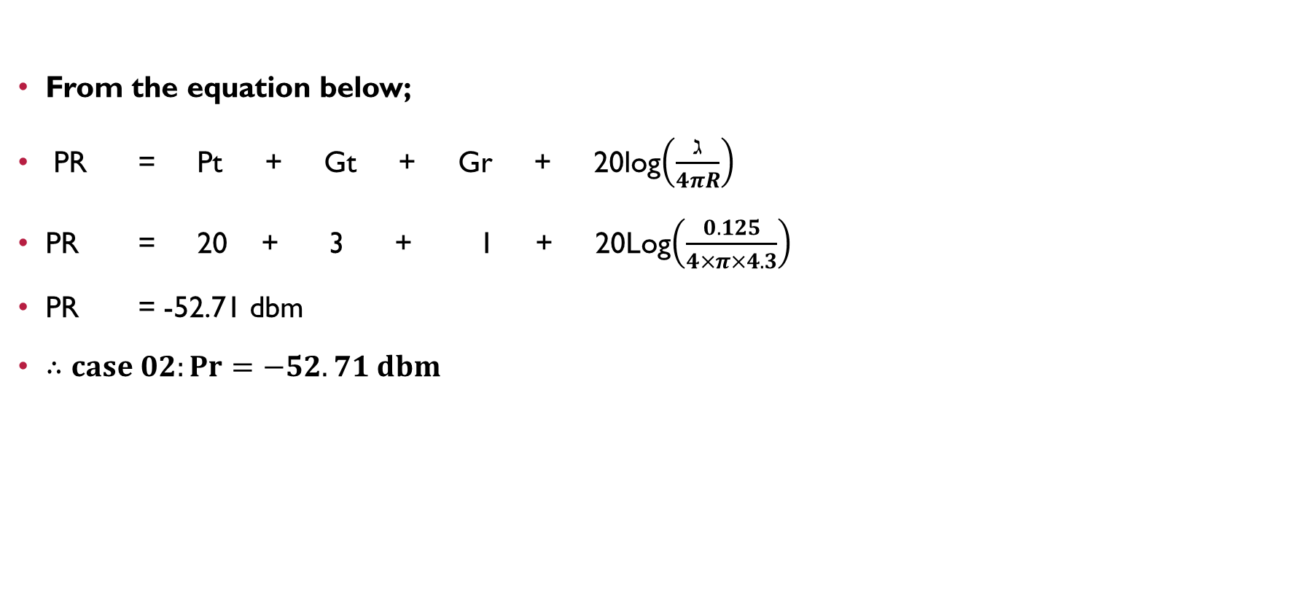

Slide 22
CASE 03: P2
R=10.3m
Pt=20dbm
Gt=3dbm
Gr=1dbm
Wavelength=0.125m
NOTE: At this point
-There is a loss of 1 wall and 1 door
-(3 + 10) dbm

Slide 23
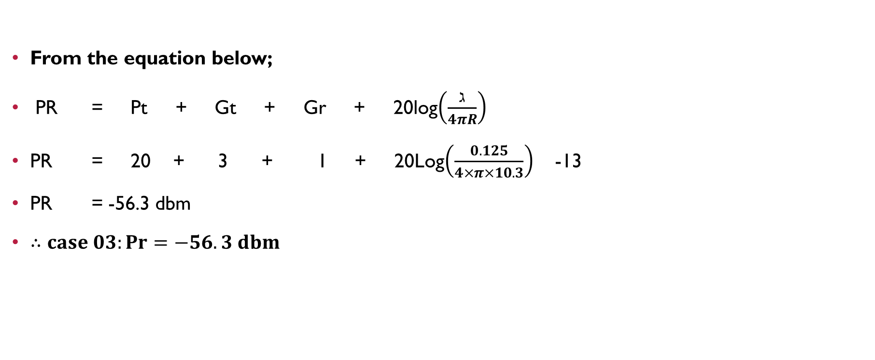

Slide 24
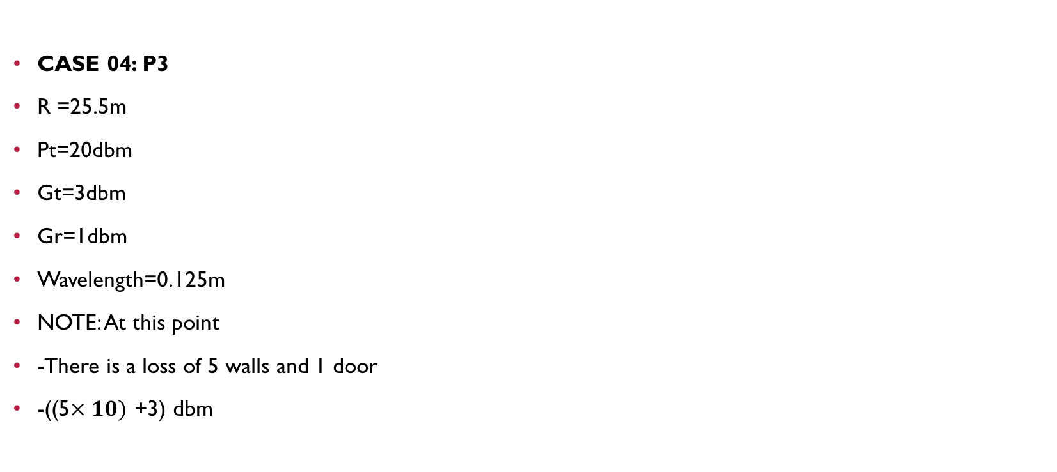

Slide 25


Slide 26
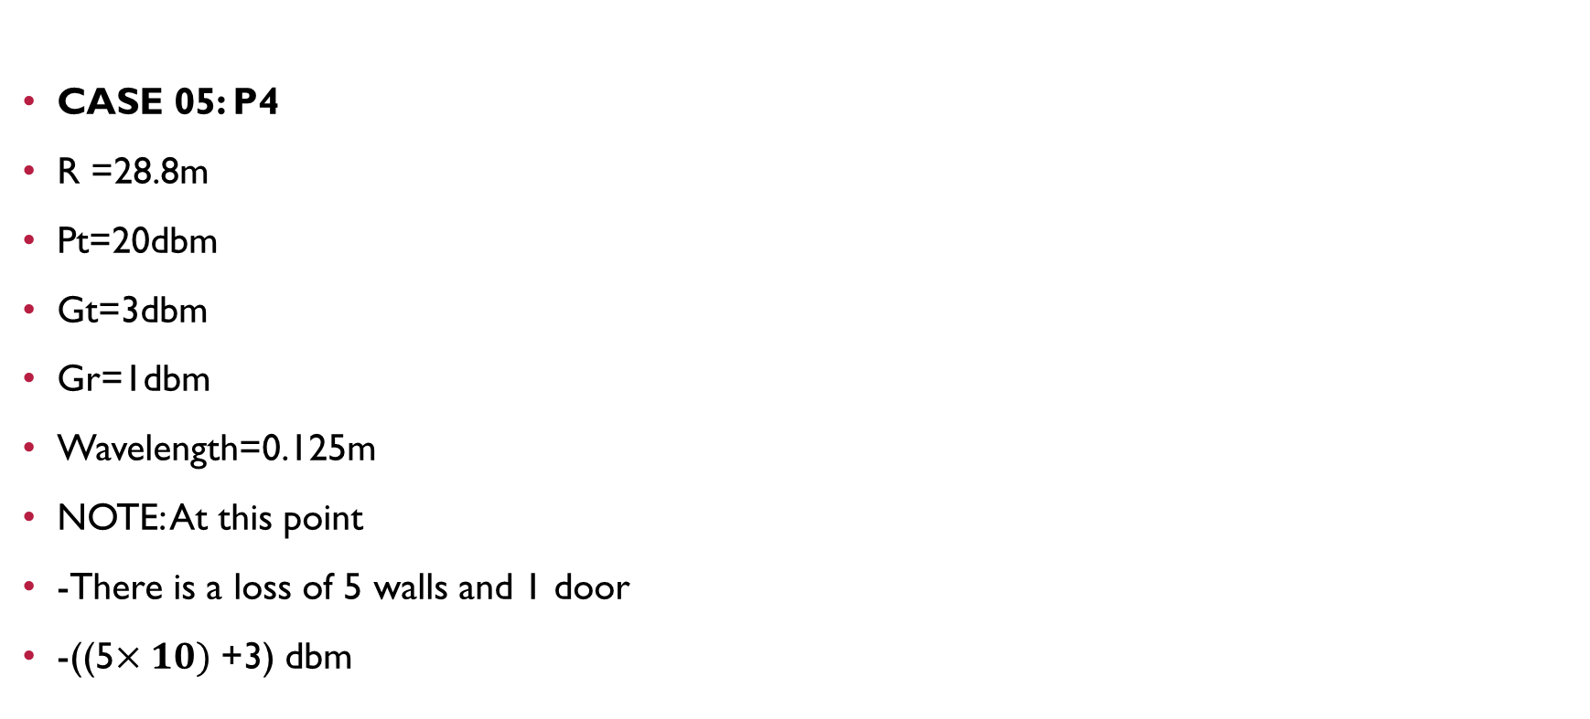

Slide 27


Slide 28
CASE 06: P5(012-STORE ROOM)
R =28.5m
Pt=20dbm
Gt=3dbm
Gr=1dbm
Wavelength=0.125m
NOTE: At this point
-There is a loss of 1 door
-(3) dbm

Slide 29


Slide 30
CASE 07: P6
R =26.9m
Pt=20dbm
Gt=3dbm
Gr=1dbm
Wavelength=0.125m
NOTE: At this point
-There is no any loss

Slide 31


Slide 32
The calculated data was tabulated below
Distance case | Point(p) | Distance(m) | Power received(dbm)
Case 01 | Po(from either side of router) | 1.3 | -18.32
Case 02 | P1 | 4.3 | -52.71
Case 03 | P2 | 10.3 | -56.3
Case 04 | P3 | 25.5 | -97.17
Case 05 | P4 | 28.8 | -98.2
Case 06 | P5 | 28.5 | -48.17
Case 07 | P6 | 26.9 | -68.1

Slide 33
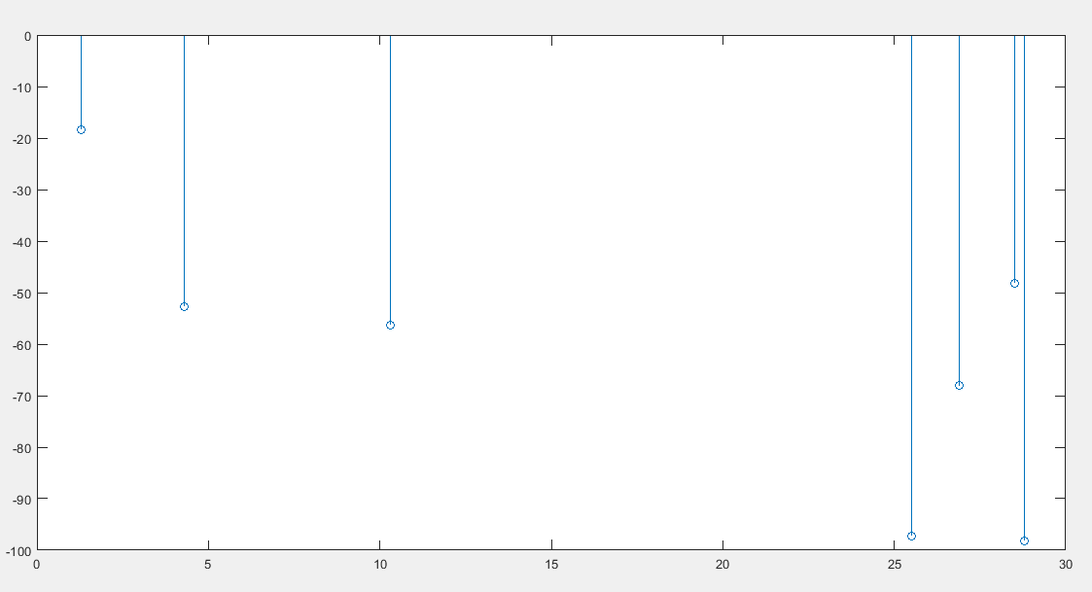
GRAPH OF POWER RECEIVED(PR) AGAINST DISTANCE BETWEEN TRANSMITTER AND RECEIVER(R)

Slide 34
Nature of the graph
the nature of the graph representing the power received by network users against their distance from a WI-FI router transmitter typically follows an inverse square law relationship (As the distance increases, the power received decreases rapidly).

Slide 35
Consider the spreading of radio waves emitted by the WI-FI router:
When a network user is close to the router, it receives a strong signal because it is within the near-field region of the router’s antenna. However, as the distance increases, the signal strength decreases due to the spreading of the radio waves in three-dimensional space. this spreading is governed by the inverse square
law, which states that” the power density of a radiating source decreases as the square of the distance from the source increases”

Slide 36
9. RECOMMENDATIONS on optimization:
The following are the ways of optimizing the problem of network in basement of administration block D;
WI-FI range extenders or repeaters placement; these devices receive the existing WI-FI signal and rebroadcast it effectively increasing the range in areas with weak signals.
Implementing Mesh WI-FI system; mesh system uses multiple interconnected nodes to create a seamless network and ensuring a strong signal throughout the area by extending the network coverage in basement building of administration block D.

Slide 37
Strategic placement of WI-FI access points; Aps should be positioned away from obstructions like walls or large objects that can interfere with signals.
Network optimization; WI-FI network must be optimized to increase its performance and this may include updating firmware on routers and access points, optimizing router setting for better signal propagation, and ensuring proper security protocols are in place.

Slide 38
10.SIGNIFICANCES OF THE MINI-PROJECT
Enables efficient use of technology.
Improves connectivity.
Supports remote working.

Slide 39
11.CONCLUSION:
In summary, addressing the WI-FI network problem in basement buildings is crucial for optimizing connectivity and ensuring smooth operation of various activities. By implementing the recommended solutions, the project aims to overcome the challenges posed by basement environments and provide a reliable and efficient WI-FI network, ultimately benefiting the users.

Slide 40
REFERENCES:
www.cisco.com
support.microsoft.com
en.m.wikipedia.org

Slide 41
THANK YOU DR.TWAHIR FOR THIS MINI-PROJECT

